Slide 1
Discussion on Next Steps

Slide 2
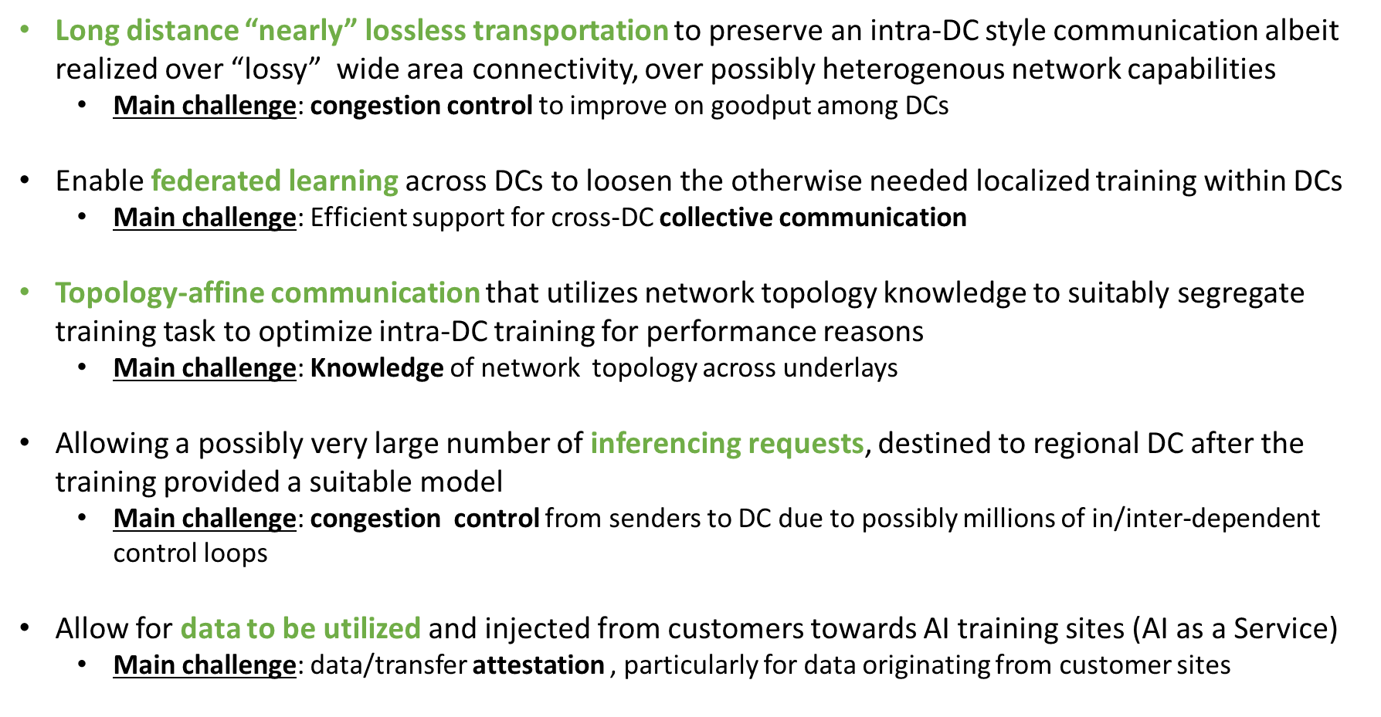
Linking to IETF: A Possible List of Concrete Next Steps
CCWG
Recognition that “special cases” for congestion control exists in work around RFC5033bis
We assert that inter-DC as well as inferencing pose challenges to existing congestion control
Proposed action: bring into RFC5033bis discussion and form a design team for possible solution(s)
TAWG
Requirement analysis in https://www.ietf.org/archive/id/draft-yao-tsvwg-cco-requirement-and-analysis-00.html
Refers generically to “distributed applications” but our cases here fall under that
Proposed action: form a design team to study potential solutions with inter-DC AI as key use case
ALTO
Exposure of network capabilities to applications is general target
Aim at applicability (of ALTO) to inter-DC AI
Proposed action: discuss with key WG members on possible actions/drafts
NASR BoF (https://datatracker.ietf.org/doc/bofreq-liu-nasr/)
Utilize trusted overlay for attestation of network traversal is key objective
Proposed action: Define applicability statement for inter-DC AI in AIaaS setting, i.e., involving customer data
…and there is more like CATS (inferencing already a use case there), SPRING (for path control between DCs), RTGWG (DCI)

